Slide 1
Advanced Entity Relationship Modeling (covered in CIS 355)
Key Concepts:
Strong and Weak Entities and Relationships
Extended Entity Relationship Model
Subtypes & Supertypes
Subtypes inherit attributes (including PK) and relationships from parent
Specialization Hierarchies
Subtype Discriminators
Disjoint and Overlapping Subtypes
Partially and Totally Complete Supertypes
Entity Clustering
Make EERDs more readable by replacing multiple entities and relationships with a single "virtual" entity.

Slide 2
Strong & Weak Entities
An entity is existence-dependent if its existence depends on the existence of an entity occurrence of another entity, known as a parent entity.
E.g. CHILD and PARENT – a child can only exist if a parent exists that it is the child of.
Implement this as a foreign key that cannot be null.
An entity is weak if it is existence-dependent and its PK is partially or totally derived from its parent entity’s PK.
An entity that is existence-independent (i.e. not existence-dependent on any entity) is called a regular or strong entity.
E.g "PART is supplied by VENDOR". If some parts are produced in-house, then VENDOR attribute will be null, so PART is existence-independent (at least from VENDOR – need to consider all other entities.)

Slide 3
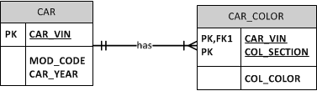
Strong & Weak Relationships
A relationship is strong (or identifying) if the foreign key of one entity is a component of the primary key of the related entity. Otherwise the relationship is weak (or non-identifying).
E.g.
A weak relationship is denoted by a dashed line in Crow's Foot notation.
A weak entity must be part of a strong relationship.
Weak Entity
Strong Relationship

Slide 4
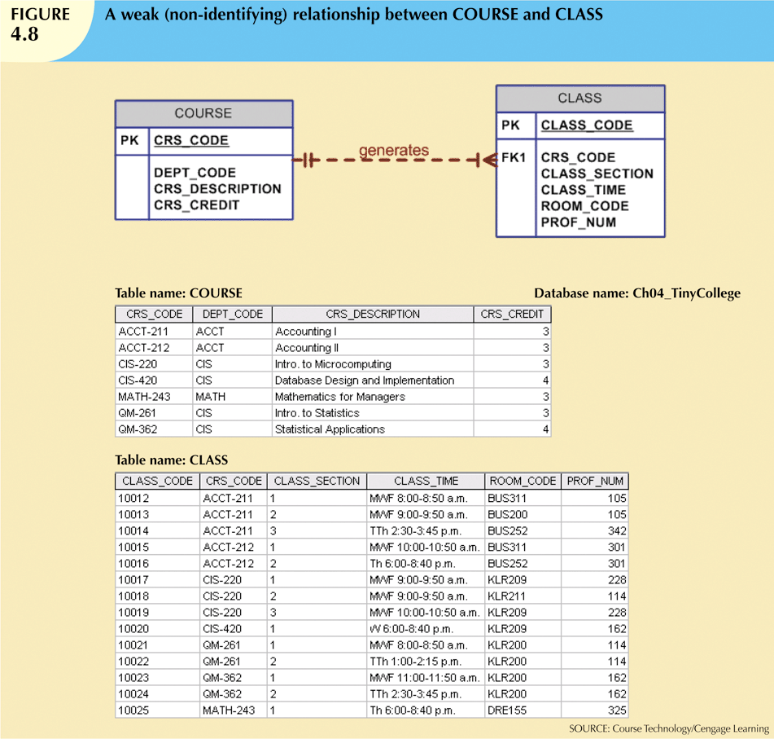
Weak Relationship - Example
CLASS is existence-dependent
on COURSE .

Slide 5
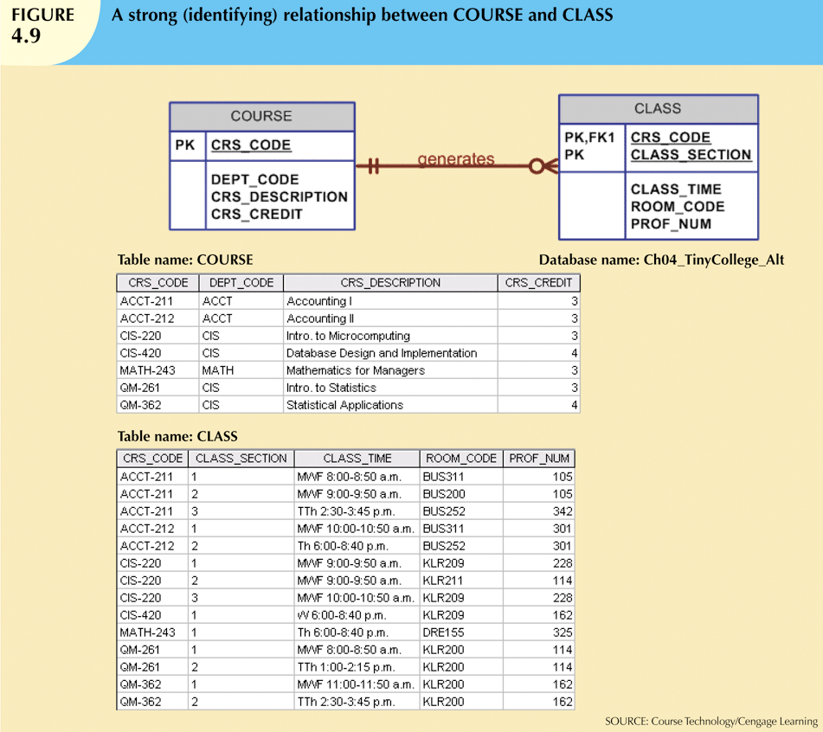
Strong Relationship - Example
Circle means optional participation – see later.
CLASS is existence-dependent
on COURSE .

Slide 6
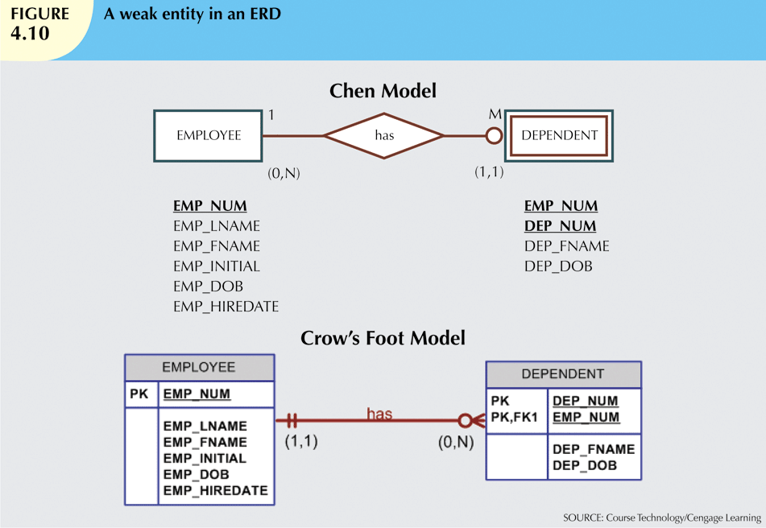
Weak Entity - Example

Slide 7
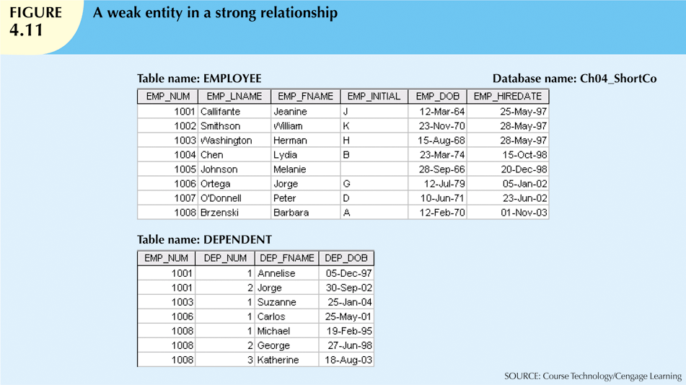
Weak Entity – Example (ctd)

Slide 8
The Extended Entity Relationship Model
The extended (or enhanced) entity relationship model adds semantic constructs (relating to entity supertypes, subtypes and clustering) to the original entity relationship model.
A diagram using this model is called an EER diagram (EERD).
Motivation: In many situations, entities can be grouped together based on shared characteristics.
E.g. An airline employs pilots, mechanics, accountants, etc.
The pilots share some characteristics with other types of employees (e.g. name, hiring data).
But they also have special characteristics, such as training, flight checks, etc. Putting these attributes into a single EMPLOYEE table creates many nulls.

Slide 9
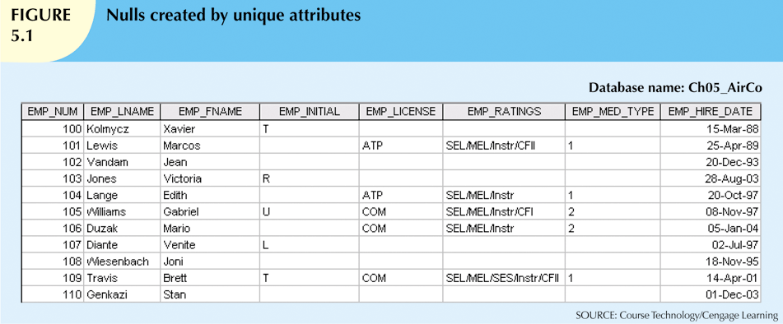
Example
Look at the table below.
Notice how sparse the data is (large number of nulls).
The attributes with nulls result from the presence of employees who are not pilots (or don’t have a middle initial).

Slide 10
Entity Supertypes and Subtypes
An entity supertype is a generic entity that contains characteristics that are common to a number of different entities (its subtypes).
Each entity subtype:
contains characteristics that are unique to that entity subtype.
inherits attributes and relationships of its supertype.
Including their primary key.
E.g. Make PILOT, MECHANIC, ACCOUNTANT subtypes of EMPLOYEE.
Entity supertypes are also called higher-level entities, or parent entities.
Entity subtypes are also called lower-level entities, or child entities.

Slide 11
Specialization Hierarchies
A specialization hierarchy depicts the arrangement of entity supertypes and subtypes.
The relationships in a specialization hierarchy are described as “is-a” relationships. These are 1:1 relationships.
E.g. a pilot is an employee.
A supertype can have many subtypes.
Every subtype can have only ONE supertype to which it is related by an is-a relationship; i.e. only one parent entity.
All subtypes inherit their PK from their parent.
There is a concept of specialization lattice, which allows for more than one parent entity. See Object-Oriented Databases.

Slide 12
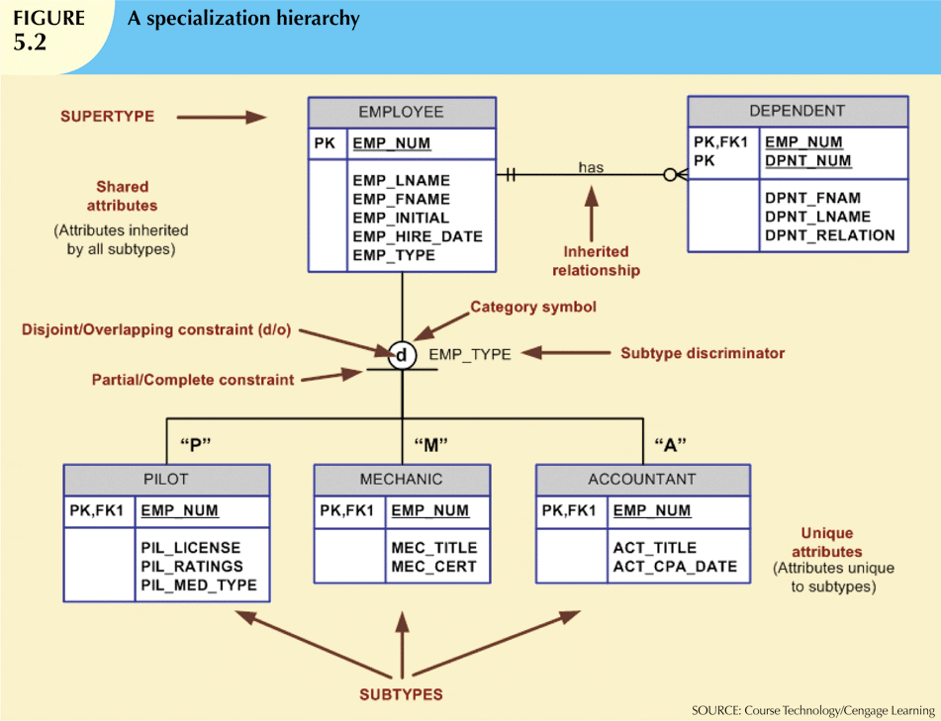
Example

Slide 13
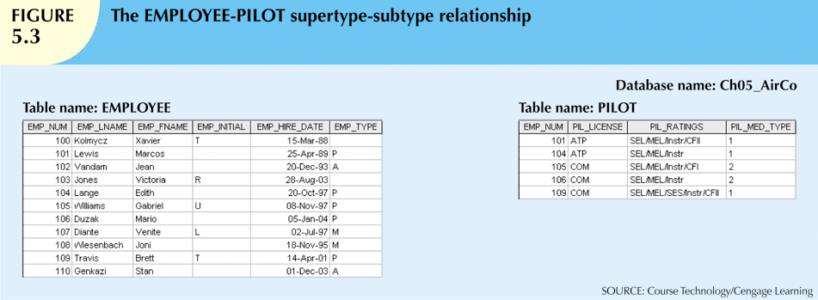
Example (ctd)
Below, EMPLOYEE is the supertype and PILOT is the subtype.
Note the primary key for both tables is EMP_NUM.
PILOT inherits all the attributes in EMPLOYEE as well as all relationships involving EMPLOYEE.
E.g. the relationship with DEPENDENTs.

Slide 14
Subtype Discriminators
A subtype discriminator is the attribute in the supertype that determines to which subtype each supertype occurrence is related.
E.g. in the EMPLOYEE table, the attribute EMP_TYPE is the subtype discriminator.
EMP_TYPE is: “P” for PILOTs,
“M” for MECHANICs
“A” for ACCOUNTANTs.
Usually, the comparison condition for the subtype discriminator is equality.
Sometimes the subtype discriminator is based on other type of comparison.
E.g. 2 sub-types of PILOT, distinguished by number of hours flown.

Slide 15
Disjoint and Overlapping Subtypes
Disjoint (or non-overlapping) subtypes are subtypes each of whose entity set has no intersection with any other subtype’s entity set.
i.e. each entity instance of the supertype can appear in only one subtype.
E.g. The airline example. An employee probably cannot be more than one of a pilot, mechanic, accountant.
Symbolized by a “d” in the circle.
Overlapping subtypes are subtypes where an entity instance of the supertype may appear in more than one subtype.
E.g. PERSON has subtypes EMPLOYEE and STUDENT.
The same person can be both an employee and a student.
E.g. EMPLOYEE has subtypes PROFESSOR and ADMINISTRATOR.
The same employee can be both a professor and an administrator.
Symbolized by an “o” in the circle.

Slide 16
Completeness Constraint
Partial completeness means NOT every supertype entity occurrence is a member of a subtype.
E.g. In the airline example, we have subtypes for PILOT, MECHANIC, and ACCOUNTANT, but clerks are not in any subtype. Clerks do not have any distinguishing characteristic. They are stored in the EMPLOYEE table.
Symbolized by a circle over a single line.
Total completeness means every supertype entity occurrence is a member of a subtype.
E.g. In a college example, STUDENT has two subtypes, UNDERGRAD and GRADUATE. A student must be in one of those two classifications.
Symbolized by a circle over a double line.

Slide 17
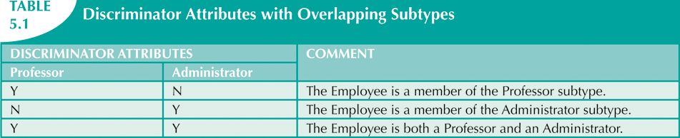
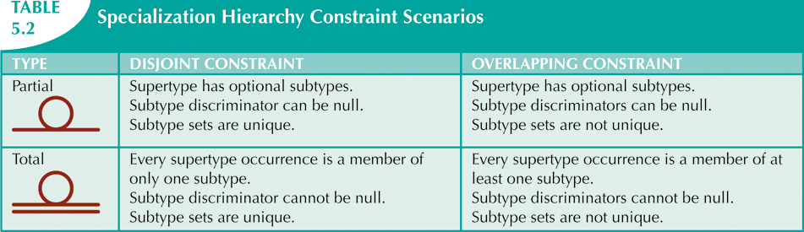
Denoting & Implementing Constraints
Implementing overlapping subtypes requires a subtype discriminator for each subtype.
A constraint can be disjoint & partial, disjoint & total,
overlapping & partial, or overlapping & total.

Slide 18
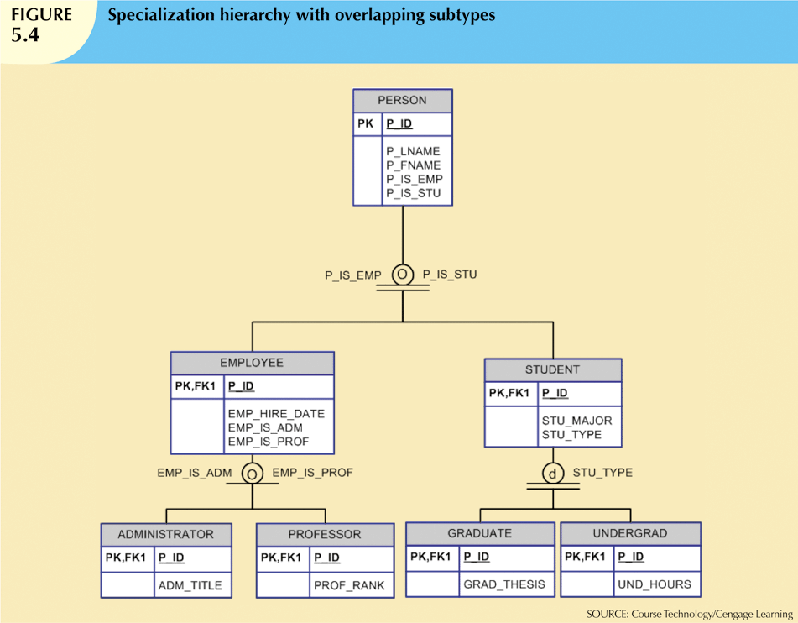
Example
“G”
“U”

Slide 19
Methods for Developing Hierarchies
Specialization
Identifies more specific entity subtypes from higher-level entity supertype.
Top-down process.
Based on grouping unique characteristics and relationships of the subtypes.
Generalization
Identifies more generic entity supertype from lower-level entity subtypes.
Bottom-up process.
Based on grouping common characteristics and relationships of the subtypes.

Slide 20
Entity Clustering
ERD diagrams can grow into hundreds of entities.
This can be hard to read and understand.
An entity cluster is a single “virtual” entity used to represent multiple entities and relationships in an ERD.
Considered “virtual” or “abstract” because it is not actually an entity in the final ERD.
Is a temporary entity used to represent multiple entities and relationships to simplify the ERD and make it more readable.
Attributes are not shown for entity clusters.
E.g.
COURSE and CLASS are grouped into OFFERING.
ROOM and BUILDING are grouped into LOCATION.

Slide 21
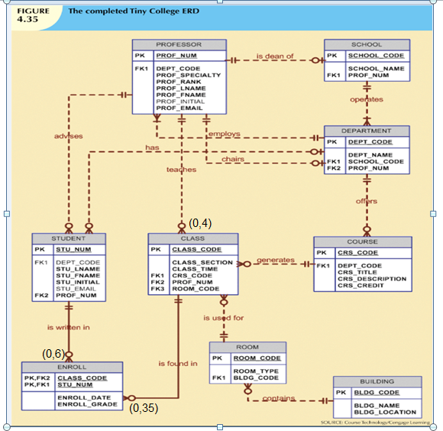
Example – Tiny College ERD

Slide 22
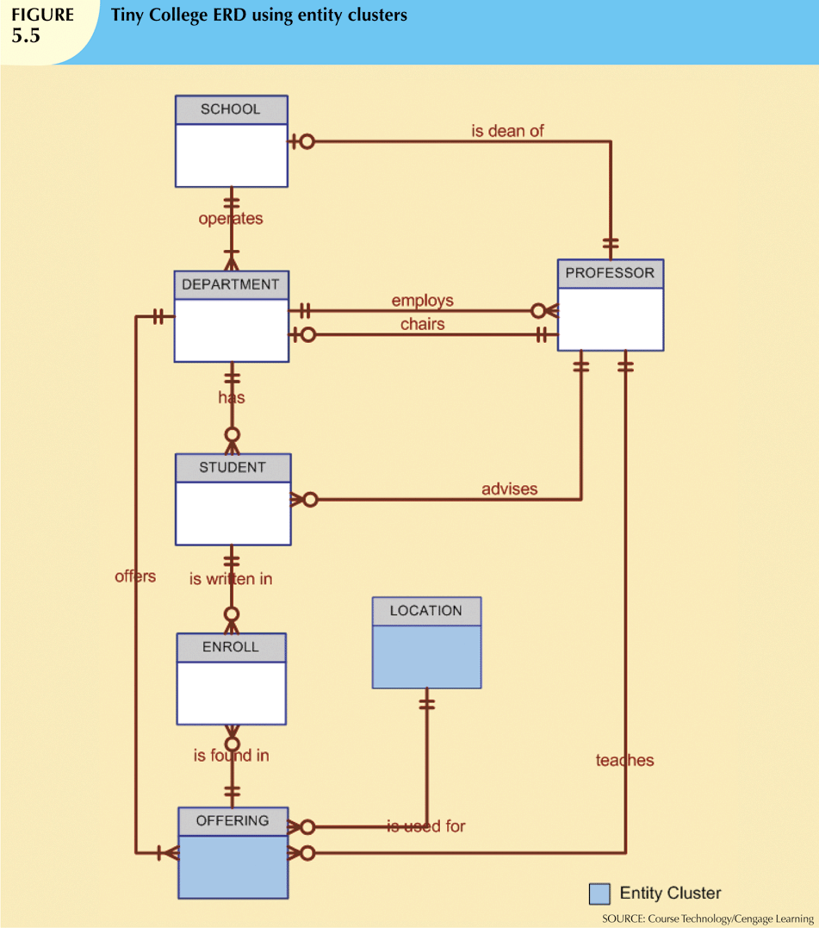
Example of Entity Clustering

